Slide 1
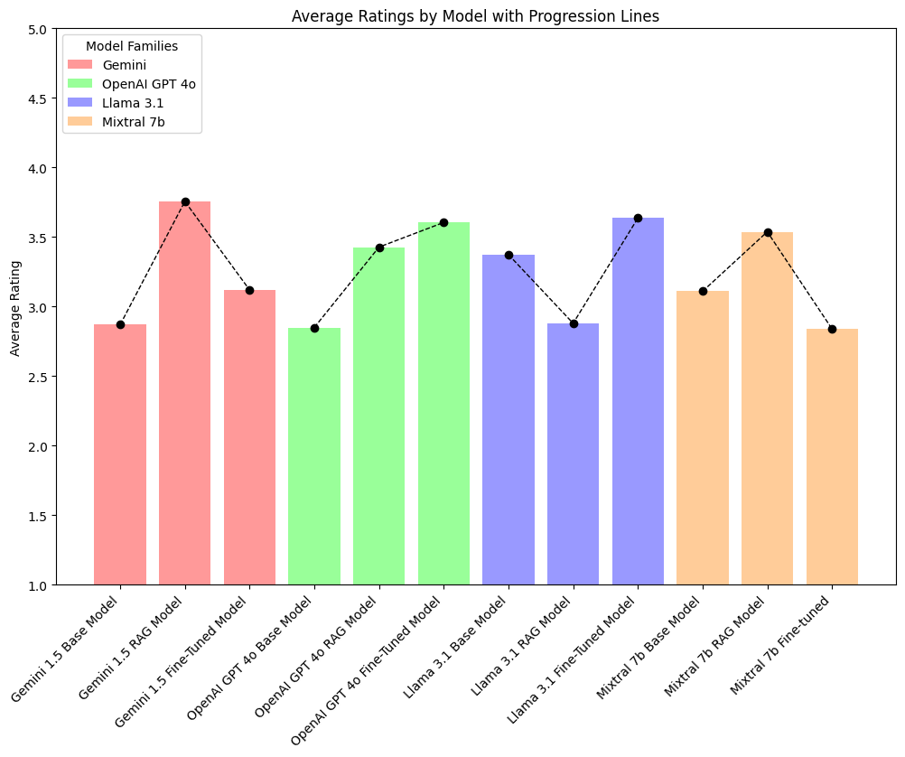

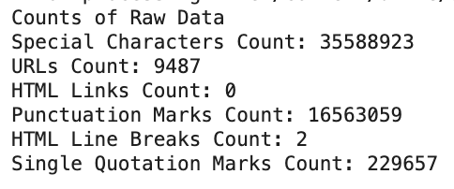
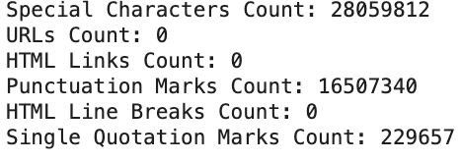
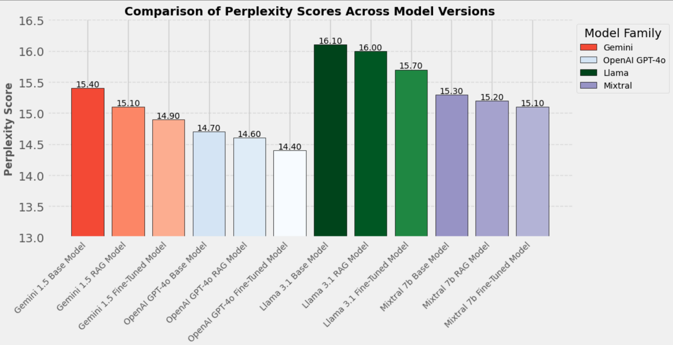
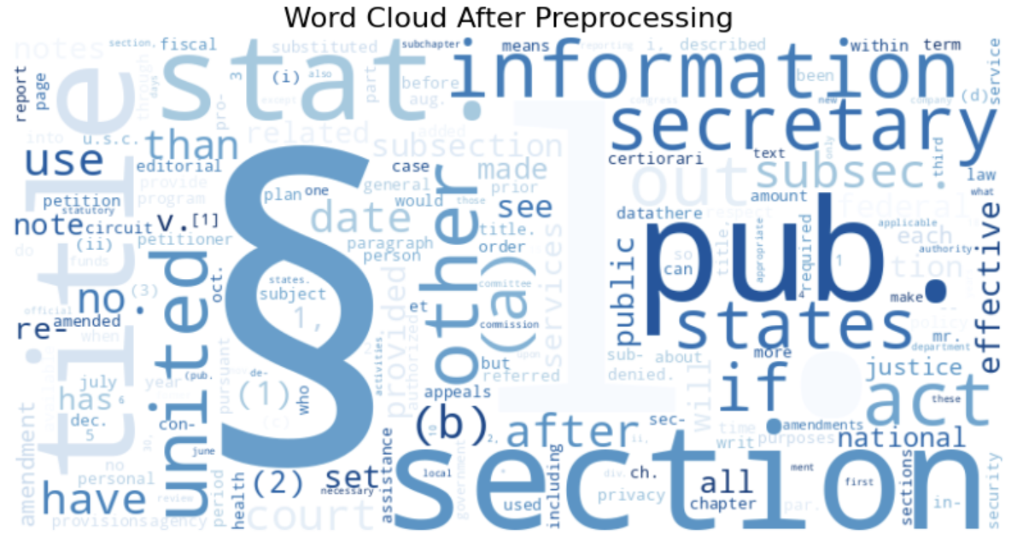
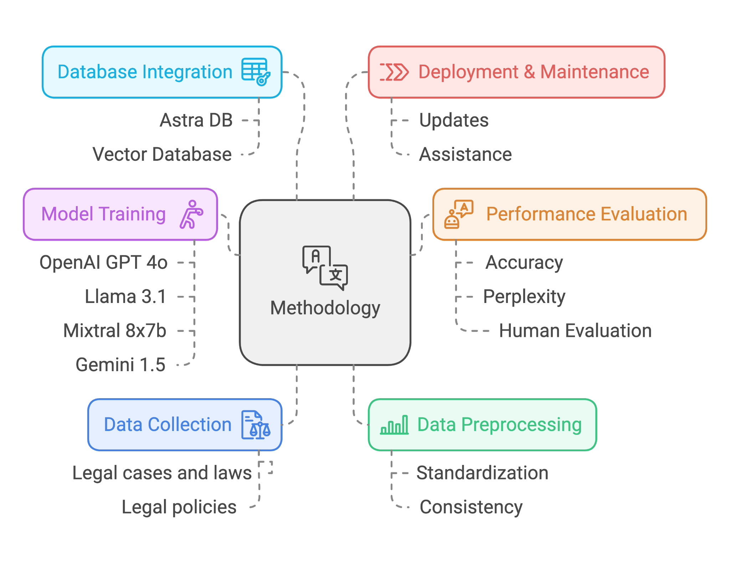
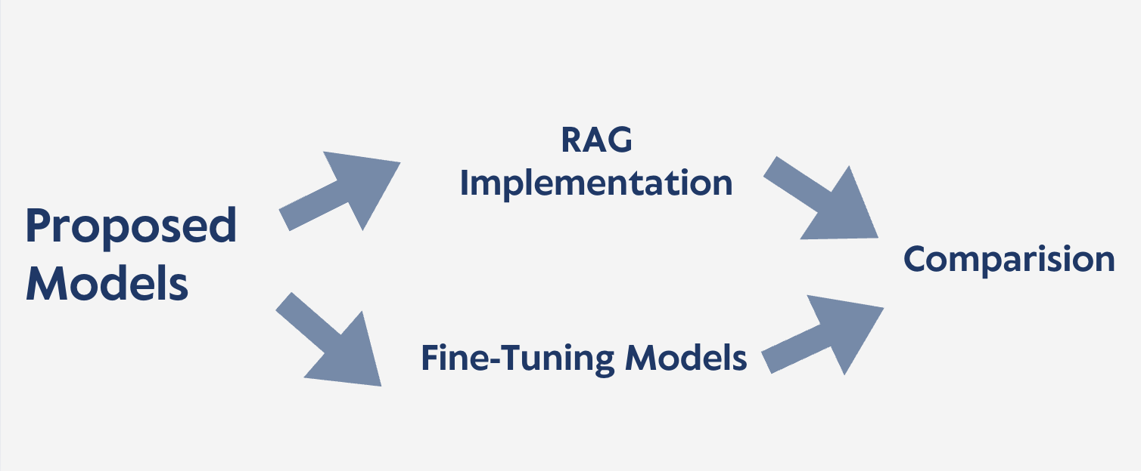
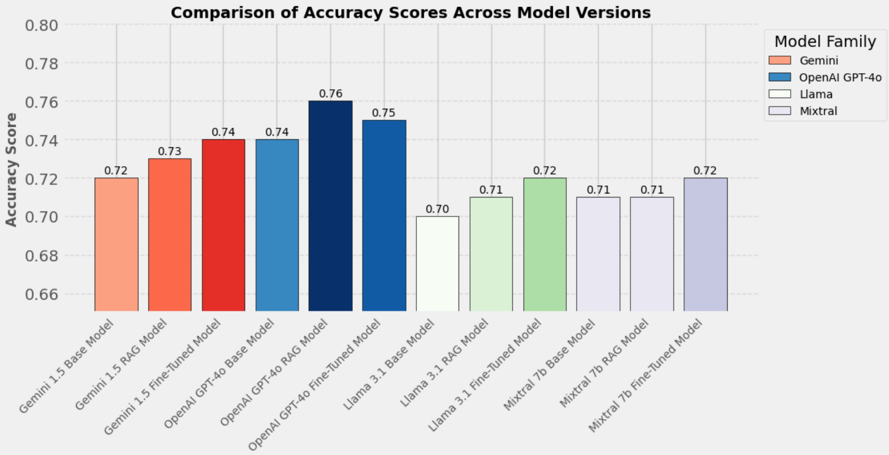
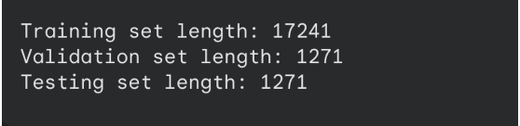
Applied Data Science Department
LexLLM: Personal AI Legal Assistant
Project Advisor: Dr. Simon Shim, Dr. Lee C. Chang
Abdul Sohail Ahmed,.
Saklecha, Sourab Rajendra
Sampath Kumar, Namratha
Khamker, Yuti Ashwin
Kutty Shivakumar, Swetha Neha
Introduction
Analysis and Results
There are overflowing amount of legal codes, past cases, and policies with complex legislative framework that makes it difficult for common citizens to keep track of amendments and also understand the legal terminologies. The project addresses the problem by providing responses to the user queries based on their experience with legal concepts.
The initial processing techniques substantially enhanced the dataset's quality, resulting in more efficient analysis. Stopword removal, pronoun elimination, lowercase conversion, and noise removal (such as URLs and HTML elements) were among the key transformations. These steps ensured consistency in text representation, minimised repetition, and focused the dataset on significant substance, laying the groundwork for next steps.
A comparison of the raw dataset and the preprocessed dataset demonstrates the significant consequences of preprocessing. The raw information included approximately 35 million special characters, 16 million punctuation marks, and roughly 9,500 URLs, all of which added unwanted noise. After preprocessing, special characters were reduced by 20%, and all URLs and HTML tags were removed, resulting in a cleaner, more structured dataset that meets analytical needs.
Evaluation and Results
Metrics for Evaluation:
Perplexity: Lower values indicate better model confidence in predicting correct answers.
OpenAI Evaluation Accuracy: Higher values denote better quality answers based on the evaluation set.
Human Evaluation : 76 responses collected over 12 days. Skill levels: 28% Beginner, 45% Intermediate, 27% Advanced.
Evaluation Dataset:
100 Q&A pairs from real-world legal contexts were used.
Responses were limited to 100 tokens for uniformity.
Model Performance Highlights:
Perplexity Scores:
OpenAI GPT-4o Fine-Tuned Model: Achieved the lowest perplexity (13.4), indicating the highest confidence.
Gemini 1.5: Improved by 3.2% from Base (15.4) to Fine-Tuned (14.9).
Llama 3.1: Improved by 2.5% from Base (16.1) to Fine-Tuned (15.7).
Mixtral 8x7b: Minimal improvement of 1.3%.
Summary/Conclusions
The main goal of the project is to make life of citizens better by providing easier access to the legal content in most understandable format (by making use of summaries).
One of the focus of the project is to determine the effect of utilizing RAG and Fine-Tuning on the performance of chatbot application.
The project make use of the strength of each of the selected LLMs to meet the intended goal.
LexLLM application successfully able to simplify the access to the legal documents and frameworks which resulted in improved navigation and access to the legislative codes, policies and past cases.
Incorporating RAG and Fine-Tuning resulted in more laser focused legal based responses to user queries, reducing dependence on legal experts.
It benefits general citizens, policymakers, researchers and lawyers alike.
The word cloud underlines preprocessing effectiveness by highlighting key terms such as "section," "information," and "states" while reducing noise. It represents the legal and administrative nature of the papers, emphasising a structured corpus.
Question-Answer Pairs
This procedure encompasses structuring the textual data into prompt-response (question-answering) pairs to optimize the large language models with the proposed model.
Data can be distributed easily for training, testing, and validation, by using a consistent split ratio, such as 80:10:10.
Key References
Methodology
[1] Gemini Team. (2024) Gemini 1.5: Unlocking multimodal understanding across millions of tokens of context. https://doi.org/10.48550/arXiv.2403.05530
[2] Jiang, A. Q., Sablayrolles, A., Roux, A., Mensch, A., Savary, B., Bamford, C., … (2024). Mixtral of Experts. https://doi.org/10.48550/arXiv.2401.04088
[3] Llama Team (2024). The Llama 3 Herd of Models. https://doi.org/10.48550/arXiv.2407.21783
[4] OpenAI Team (2023). GPT-4 Technical Report. https://doi.org/10.48550/arXiv.2303.08774
[5] Nay, J. J., Karamardian, D., …(2023b). Large Language Models as Tax Attorneys: A Case Study in Legal Capabilities Emergence. Social Science Research Network. https://doi.org/10.2139/ssrn.4476325
Project Flow
The methodology involves integrating Data Collection of legal cases, laws and policies, followed by Data Preprocessing to ensure standardization and consistency. Using Astra DB as vector database for Database Integration, the system facilitates efficient storage.
Accuracy Scores:
OpenAI GPT-4o Fine-Tuned Model: Achieved the highest accuracy (76%).
Gemini 1.5: Accuracy increased from 72% (Base) to 74% (Fine-Tuned).
Llama 3.1: Showed a 2.9% improvement (70% to 72%).
Mixtral 8x7b: Smallest improvement, with accuracy increasing from 71% to 72%.
Advanced model training leverages GPT-4o, LLaMa 3.1, and MiXtral 8x7b, and Gemini 1.5 with performance evaluated using metrics such as Perplexity, OpenAI Evals and Human Evaluation.
The proposed models focus on RAG Implementation and Fine-Tuned Models, compared for effectiveness in handling user queries, delivering high-performance legal and legislative insights. Together, this pipeline ensures precise, scalable, and user-centric outcomes.
Acknowledgements
We are sincerely grateful to Dr. Simon Shim and Dr. Lee C. Chang for their constructive feedback, crucial guidance, and constant support throughout the project. We would also like to thank the Department of Applied Data Science for providing the necessary resources to perform different operations and ensure the successful completion of the project.
Human Evaluation:
OpenAI GPT-4o Fine-Tuned Model: Highest average rating (4.2 out of 5).
Gemini RAG Model: Outperformed its Base version by 19%.
Mixtral 7b RAG: Achieved a 25% improvement over its Base counterpart.

